Slide 1


IT8811 Project Work
M.A.M. COLLEGE OF ENGINEERING AND TECHNOLOGY
Siruganur, Tiruchirappalli – 621 105.
Project Title: Web based solution for road management and public complaint registry
Register Number | Name of student
812019205009 | Ganesh Kumar R
812019205002 | Akash E
812019205049 | Surya M
Under the esteemed guidance of
Supervisor Name: Mathumitha M
Designation: Assistant Professor, IT
Version: MAMCET_PR-1.1
Notes:
Notes for Teachers:
The Synopsis presentation should contain 1. Real life applications 2. Overview of the subject 3. PO’s CO’s of the course 4. Individual Units overview 5. Lesson Plan 6. Flip Class topics
“ Be professionally dressed and use a QUALITY PEN. Never hand an ordinary PEN as a Cosmetic Effect”

Slide 2
Web based solution for road management and public complaint registry

Slide 3
Content in this presentation
Sl. No. | Details | Slide Number
1 | Problem Statement | 4
2 | Abstract | 5
3 | Introduction | 6
4 | Literature Survey | 7
5 | Existing System | 10
6 | Proposed Solution | 11
7 | Block diagram | 12
8 | Bibliography | 13
9 | Modules | 14
10 | Modules Description | 15
11 | Conclusion | 18

Slide 4
Problem Statement
To provide safe, reliable and efficient Road management system.

Slide 5
Abstract
Management of rural road network maintenance is a complex management process.
Road Maintenance is examined through three interrelated management functions are planning, implementation and maintenance.
It provides a centralized platform for all stakeholders involved in the maintenance process, including citizens, road inspectors, and government agencies.

Slide 6
Introduction
Our web application is designed to streamline and simplify the process of maintaining and managing the roads in your community.
It ensures the safety and reliability of the roads for both pedestrians and vehicles.
The data provided by the application to make informed decisions about budget allocation and resource management.

Slide 7
Literature Survey
Sl. No. | Details of the paper
1 | Development of Road Maintenance Management System Based on WebGIS
Objective | Methodology | Result
To ensure the structural safety of roads and bridges and protracted nature and planning of highway maintenance. | Organization of Spatial and Attribute data Space Dynamic Segmentation Technique Quick Access Mechanism Based on Quadtree Ttile | It can inquire profile information of sections and the detailed information of the road.

Slide 8
Sl. No. | Details of the paper
2 | A Crowd Sensing Application To Estimate Road Conditions
Objective | Methodology | Result
To map and measure the locations of potholes and speedbumps. | Training Set and Pre-processing Supervised learning approach | In-app Detectors: Classifiers for Speedbump Detector Classifiers for Pothole Detector
Sl. No. | Details of the paper
3 | Design and Application of Rural Road Lifecycle Management Information System
Objective | Methodology | Result
To covers planning, bidding, progress management, funds management, project acceptance, road maintenance. | Remote Sensing Image Assisting Management | Information system integrates all the business including planning, bidding, progress management, capital, acceptance, maintenance.

Slide 9
Sl. No. | Details of the paper
4 | Eyes on roads-collecting and managing data about road infrastructure
Objective | Methodology | Result
To get overview about the defects by collecting notifications about road from people-public. | Every reported defect is visualized by a red marker in this application | It aims on reporting, collecting and displaying data about roads' and their accessories defects.
Sl. No. | Details of the paper
5 | Road Maintenance Management System
Objective | Methodology | Result
Road management system predicts the future deterioration of roads. | Detection of distresses in flexible pavement by physical inspection. | Future Deterioration for the road pavement network is predicted and preventive maintenance plan is prepared.

Slide 10
Existing System
The previous road management systems are only Show the detail of the construction of road using Webgis.
Other system collect the data about the condition of road and report to the user.
Another application will helpful for planning assistant and construction supervision.
The eyes on road system similar to our system but road inspection is not involved in the system.

Slide 11
Proposed solution
The proposed solution for a web application for road maintenance and management system including the following modules:
The system should have an efficient user management module to manage the users, their roles and permissions.
Road inventory should be maintained in the system to keep track of all the roads, their length, width, type, location, and other relevant details.
The system should have a mobile-friendly interface to allow engineers, contractors, and other field personnel to access the information and update the system from the field.

Slide 12
Block Diagram
Complaint about road damages
Public
Update the street details
Manage the complaint
Database
Admin
(Municipality)
Allocating budget for damaged roads
Update contractor details for repairing roads
Officer
Monitor and report the road conditions

Slide 13
Modules
Login Module
Public complaint Module
Inspection Module
Maintenance Planning and Scheduling Module

Slide 14
Modules description
Login Module:
The login module for a road management system would require users to enter their username and password to access the system.
The login module would typically check the user's credentials against the information stored in the system's database and grant access to the user if the credentials match.
If the user enters an incorrect username or password, the login module would display an error message and prompt the user to try again. Additionally, the login module might have features such as password recovery, two-factor authentication, or captcha verification to enhance security and prevent unauthorized access to the system.

Slide 15
Public complaint Module:
A public complaint module for a road management system is a software system that allows members of the public to report issues with roads and other transportation infrastructure to the relevant authorities.
The module typically provides an online platform where users can submit complaints, which are then forwarded to the appropriate department or agency for action.
The module typically includes a user-friendly interface that guides users through the complaint submission process. Users can typically provide details about the location and nature of the problem, such as potholes, damaged signage, or road closures. They may also be able to upload photos to support their complaint.

Slide 16
Inspection Module:
The Inspection Module is a component of a road management system that focuses on the inspection of the physical condition of the road network.
The module provides standardized forms that inspectors can use to record the condition of the road network during inspections. These forms may include fields for recording the location of defects, the type and severity of defects, and any other relevant information.
The module enables road managers to track and manage defects identified during inspections. This includes assigning responsibility for repairing defects, setting priorities for repair work, and monitoring progress.

Slide 17
Maintenance Planning and Scheduling Module:
Maintenance planning and scheduling module is an essential component of a road management system, which helps to optimize the maintenance activities and ensure the safe and efficient operation of the road network.
This module involves various processes, such as planning, scheduling, and tracking of maintenance activities to ensure that they are performed in a timely and cost-effective manner.
Once the maintenance plan is developed, the scheduling module is used to create a maintenance schedule that assigns specific maintenance activities to specific maintenance crews or contractors. This schedule takes into account factors such as the priority of the maintenance activity, the availability of resources, and any constraints that may impact the schedule.

Slide 18
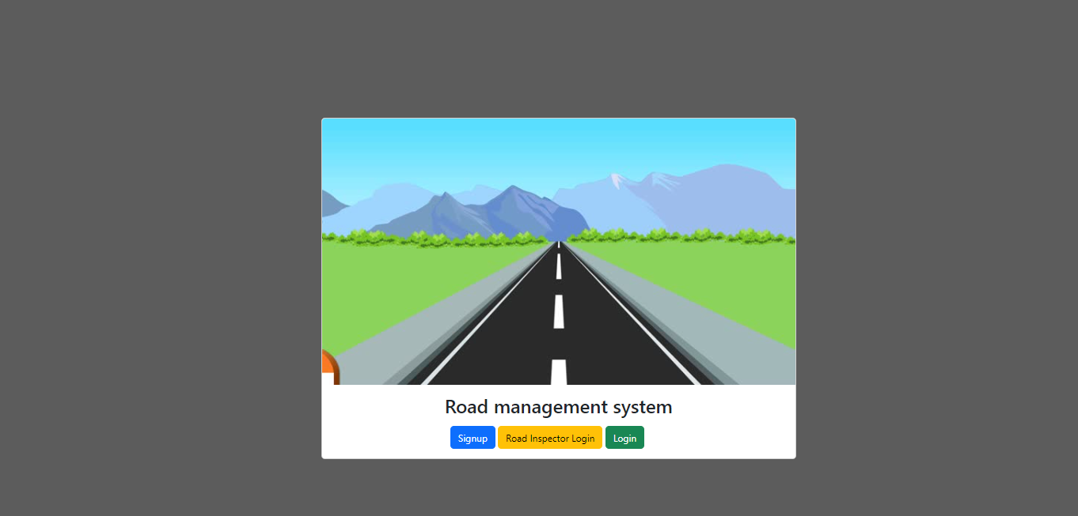
Screenshots

Slide 19
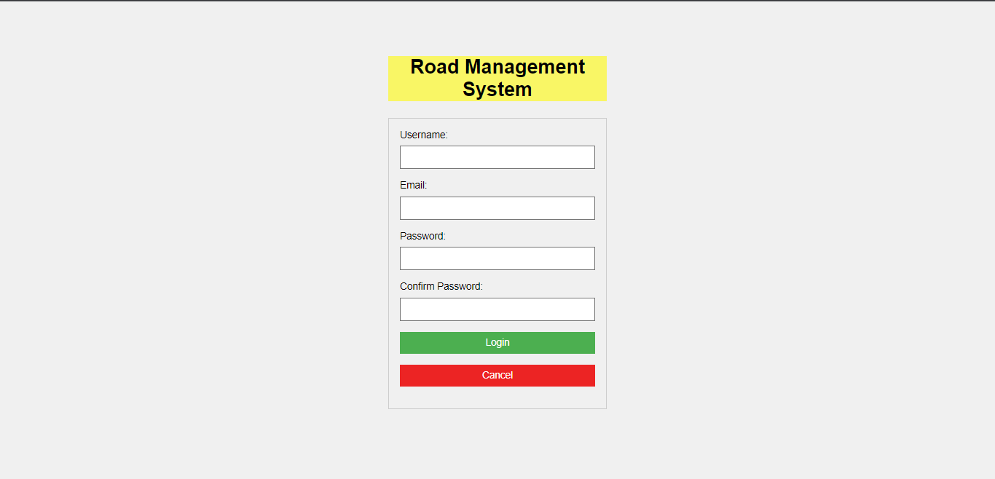

Slide 20
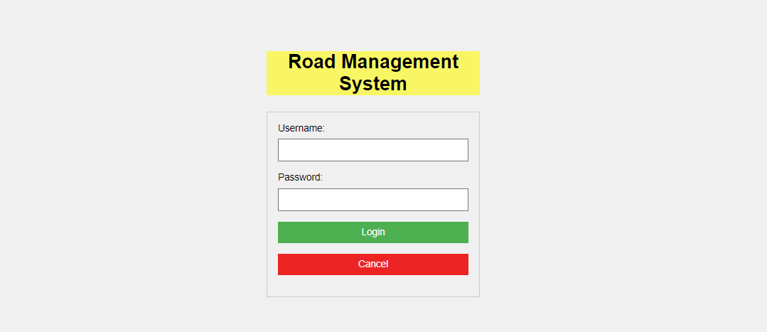

Slide 21
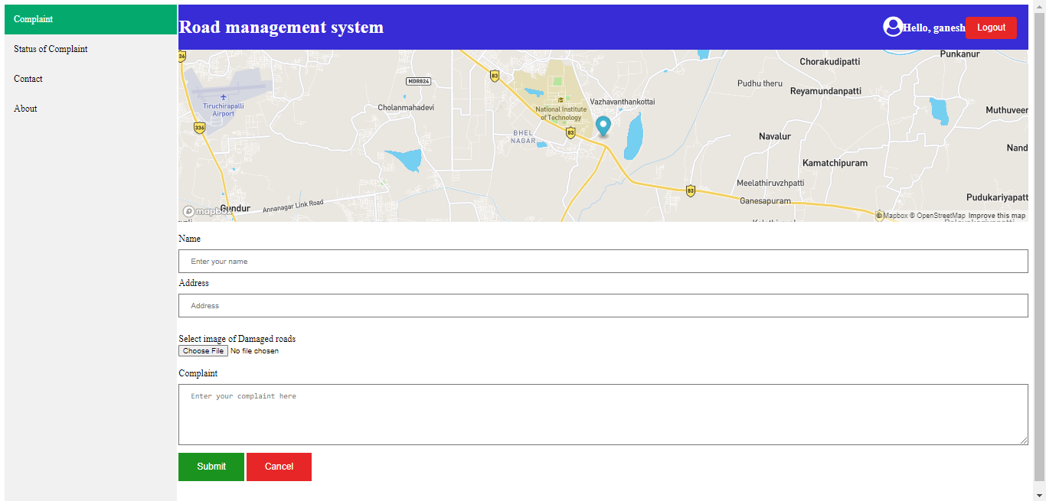

Slide 22
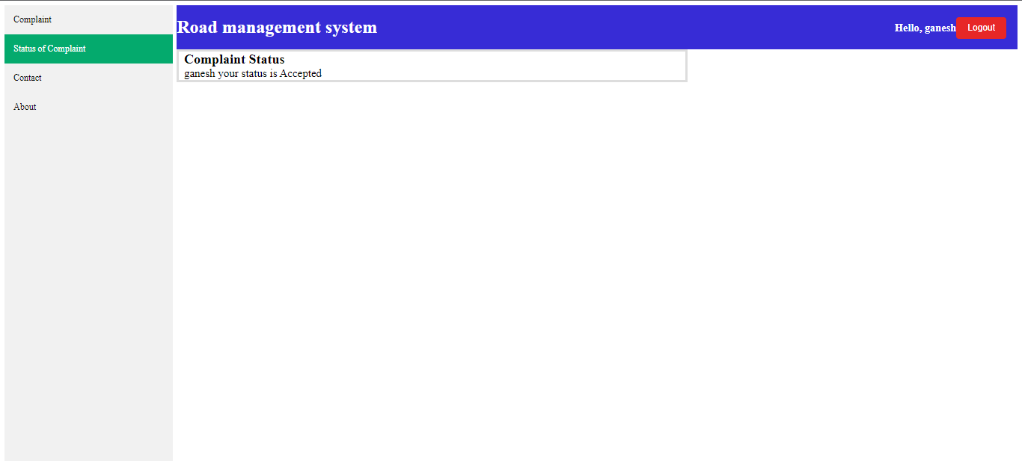

Slide 23
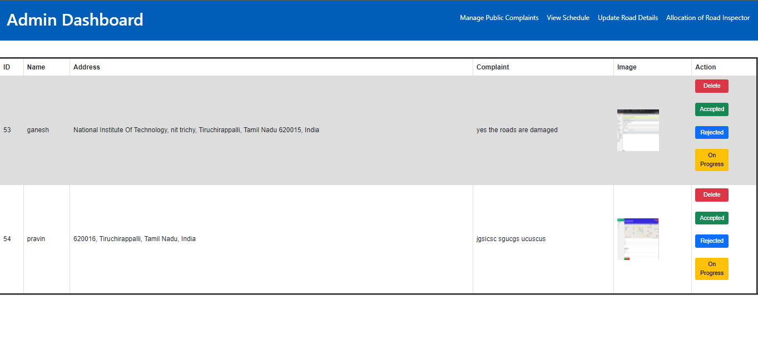

Slide 24
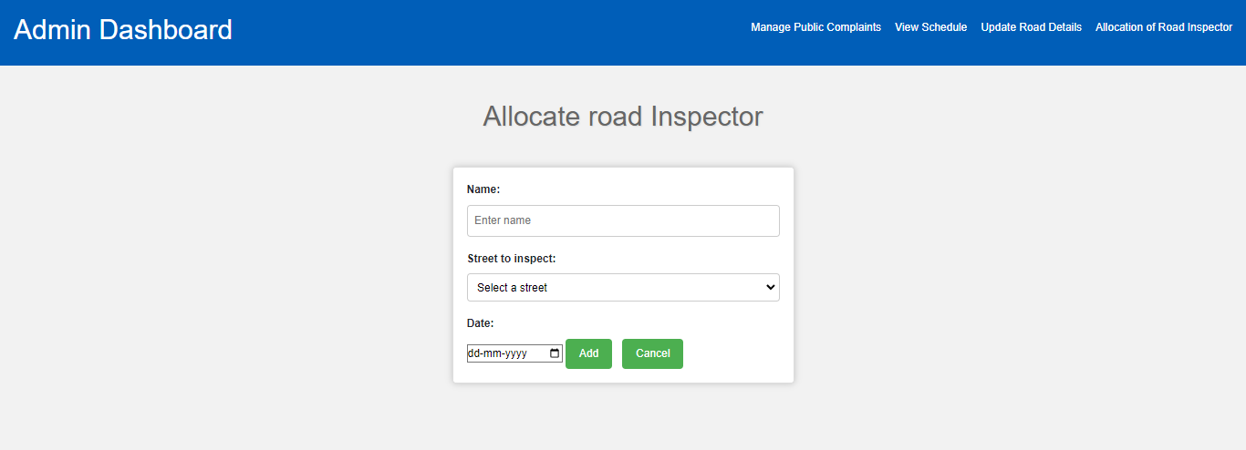

Slide 25
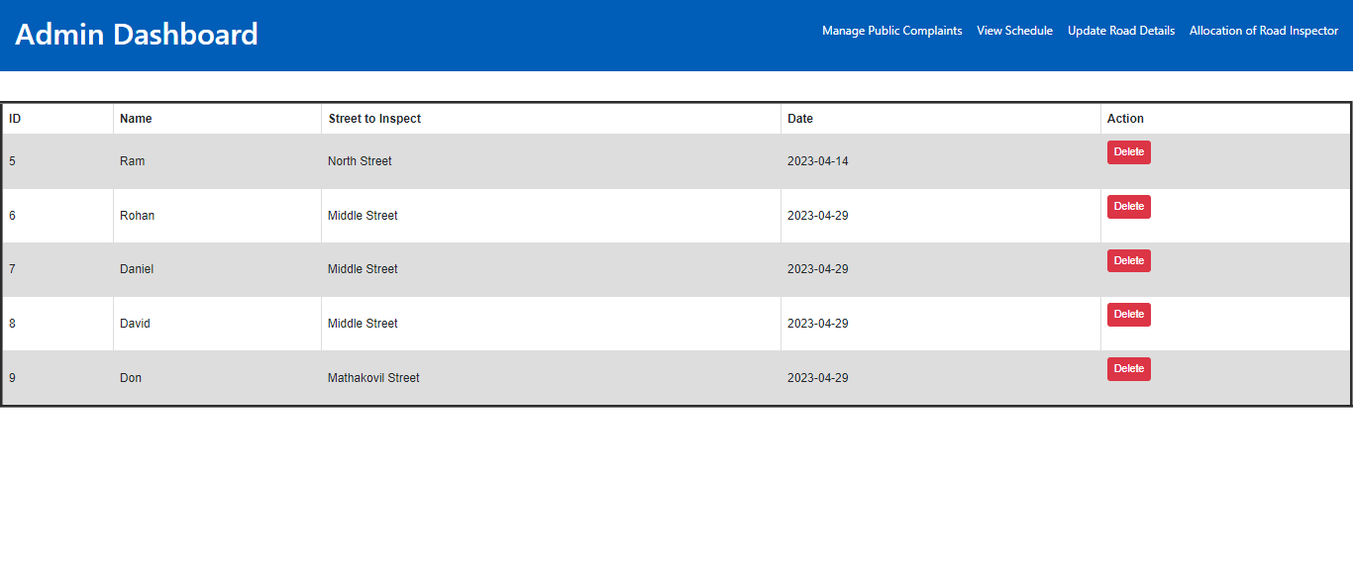
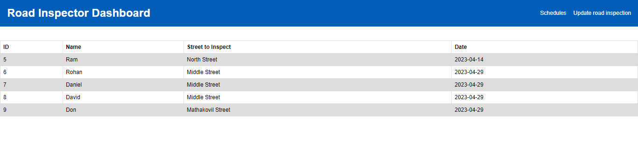

Slide 26
Features Enhancement
Future Enhancement
Real-time updates:
One possible enhancement is to integrate real-time data feeds into the application, such as traffic data, weather data, and road closure information. This could help road crews prioritize their work and respond more quickly to changing conditions.
Predictive analytics:
Another enhancement could be to use machine learning algorithms to analyze historical data and predict future road maintenance needs. For example, the application could use data on traffic volume, road age, and weather patterns to predict when certain sections of road are likely to need repairs.

Slide 27
Conclusion
Road maintenance and management system is a comprehensive solution that helps transportation authorities and public works departments to manage and maintain their road infrastructure. The system consists of various modules, including inspection and assessment, maintenance planning and scheduling, public communication, and mobile app integration. By using this system, transportation authorities and public works departments can improve the efficiency and effectiveness of their road maintenance activities, reduce costs, enhance public safety and satisfaction, and ensure compliance with regulatory requirements.

Slide 28
Bibliography
[1] Faria Kalim, Jaehoon (Paul) Jeong, and Muhammad U. Ilyas, Senior Member, IEEE “CRATER: A Crowd Sensing Application To Estimate Road Conditions”
[2] Zhenhua Liu, Liuyang Liu, Wentao Fan Transport Information Center China Academy of Transportation Sciences Beijing, China
[3] D. Piovarci and T. KovacikSlovak University of Technology in Bratislava, Faculty of Informatics and Information Technologies, Bratislava, Slovakia
[4] Ms. Priyanka D Lad 1 , Ms. Yogita Fulse 2 1 M.tech Civil ( construction management). School of Engineering and Technology, Sandip University, Nashik 2 Yogita Fulse Assistant Professor Civil Engg Department School of Engineering and Technology, Sandip University, Nashik.
[5] Feng Xiao1 , Zhou Hongyu2 , YuCaixia 3 1 Professor of Chongqing Jiaotong University, Institute of Civil and Architecture Engineering, Chongqing, China 2,3 Postgraduate student of Chongqing Jiaotong University, Institute of Civil and Architecture Engineering, Chongqing, China

Slide 29
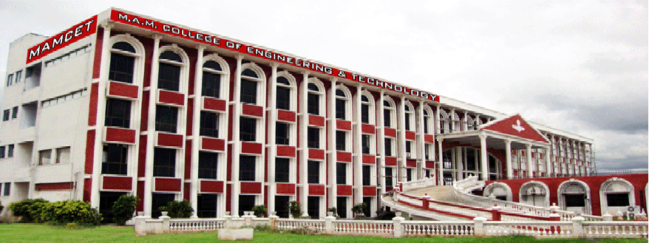
Thank You

